Slide 1




COUNTING OBJECTS
AAKARSH SHARMA RA2111003011483
UTKARSH MISHRA RA2111003011484
KARAN GANGWANI RA2111003011515

Slide 2
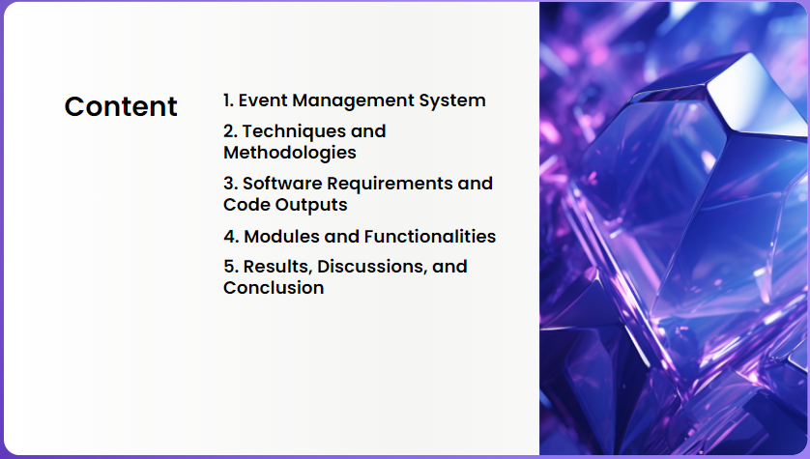

Slide 3


Slide 4
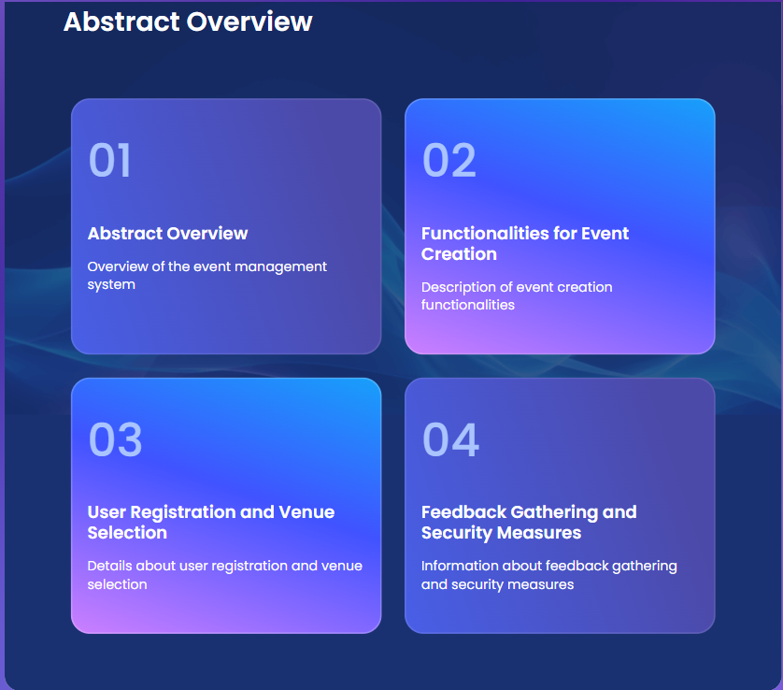

Slide 5
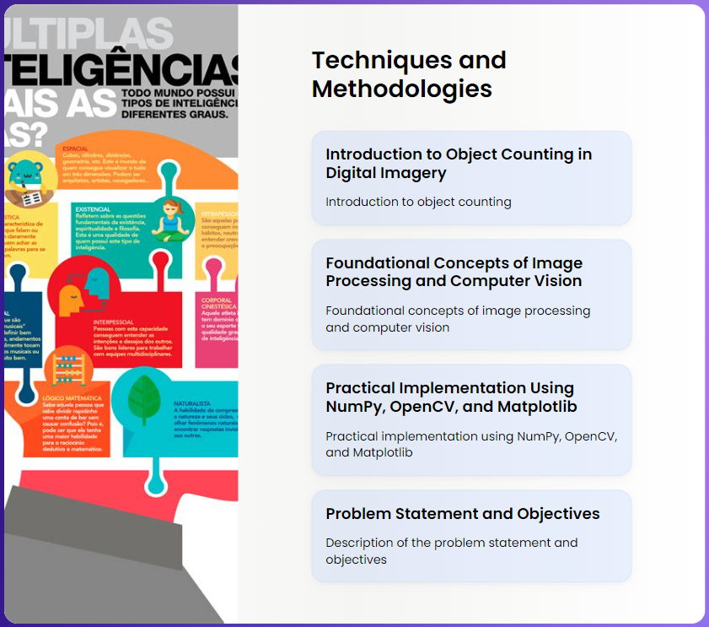

Slide 6
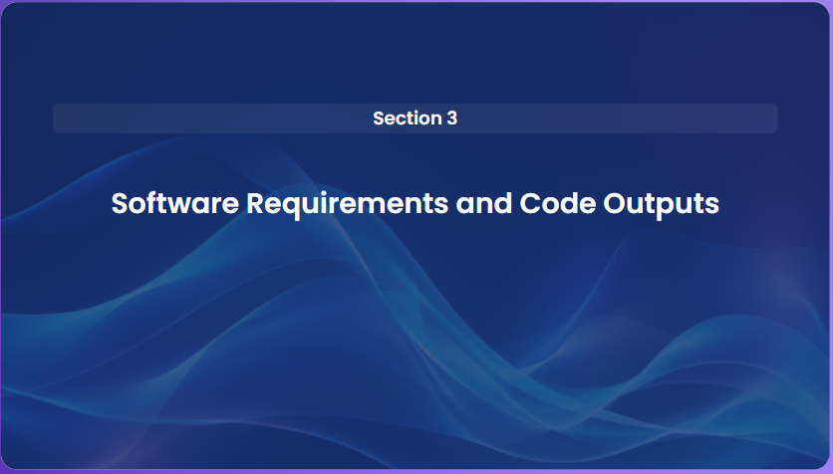

Slide 7


Slide 8
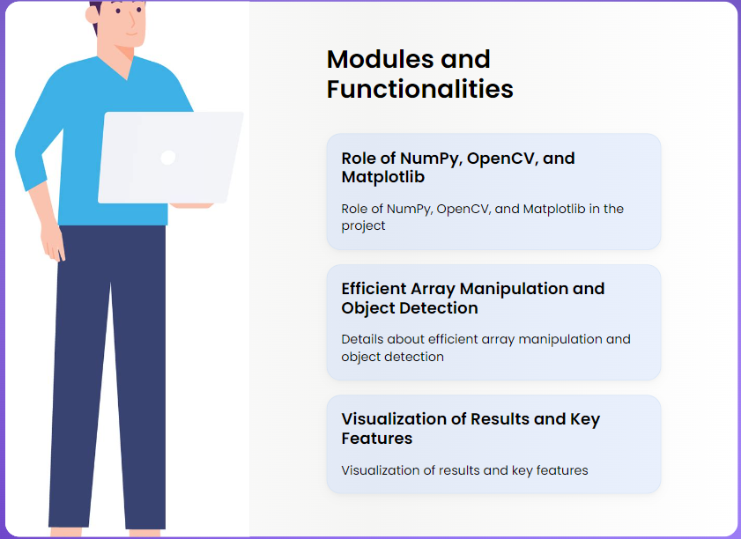

Slide 9
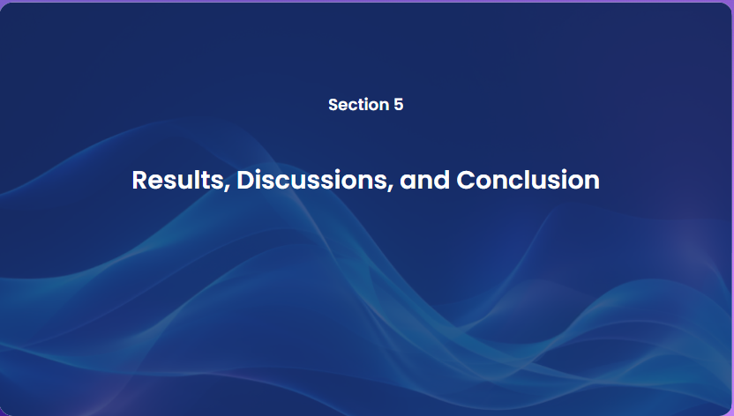

Slide 10


Slide 11


